Slide 1





Department of Computer Science and Engineering
School of Technology, GITAM
Visakhapatnam
Pre and Post Covid-19 UPI
Guide: Dr.S.Venkata Lakshmi
Students:
Vivek Chadaram
Nikhil Medisetty
Pasyanthi Sagi
Sandeep Maremalla

Slide 2







OBJECTIVES
1) | To analyse the UPI data
2) | To study the impact of Covid-19 on UPI
3) | To make Predictions UPI transactions
•
•
•
To study the concept of UPI.
To know the impact of PI.
To study the growth o PIs due to covid pandemic.

Slide 3
Problem Description
With the lockdown during Covid-19, It became quite a task to complete payments. This heavily impacted the usage of UPI. This led to a sudden surge in the number of transactions done using UPI.

Slide 4
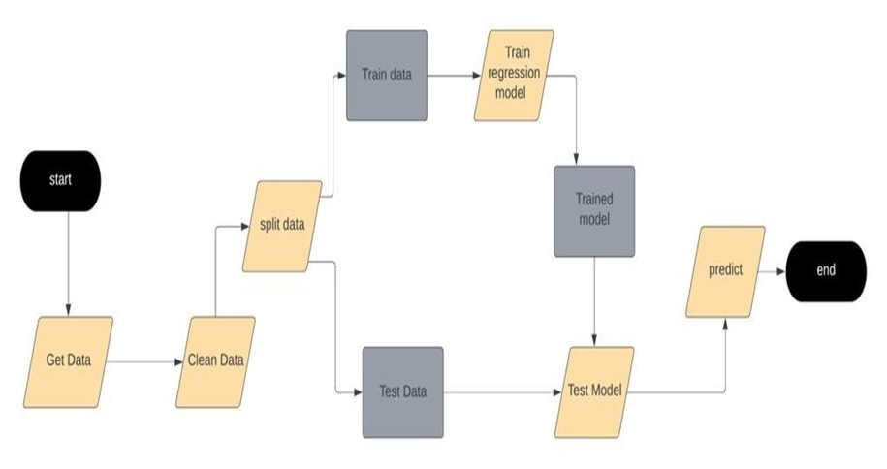

RESEARCH METHODOLOGY
LEARN

Slide 5



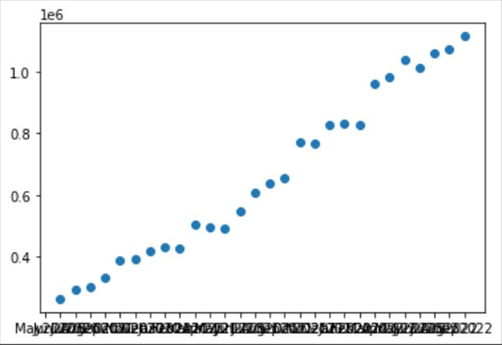
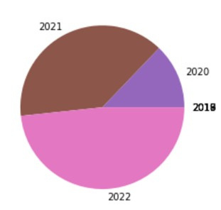

Results

Slide 6


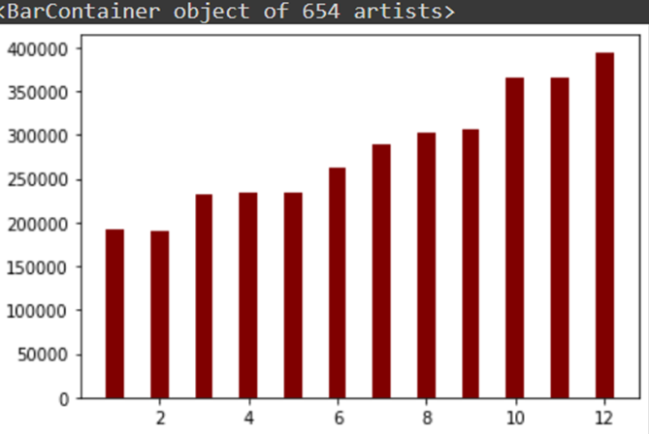
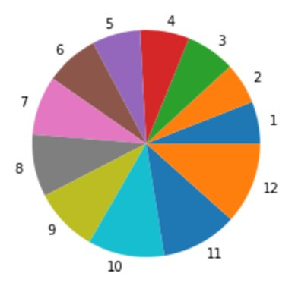


2021 DATA

Slide 7


Thank You

